Slide 1
Employee – Time Off Request
Step by Step guide for requesting Paid Time Off through our Workforce Now ADP portal.
Copyright © 2015 ADP, LLC. Proprietary and Confidential.

Slide 2
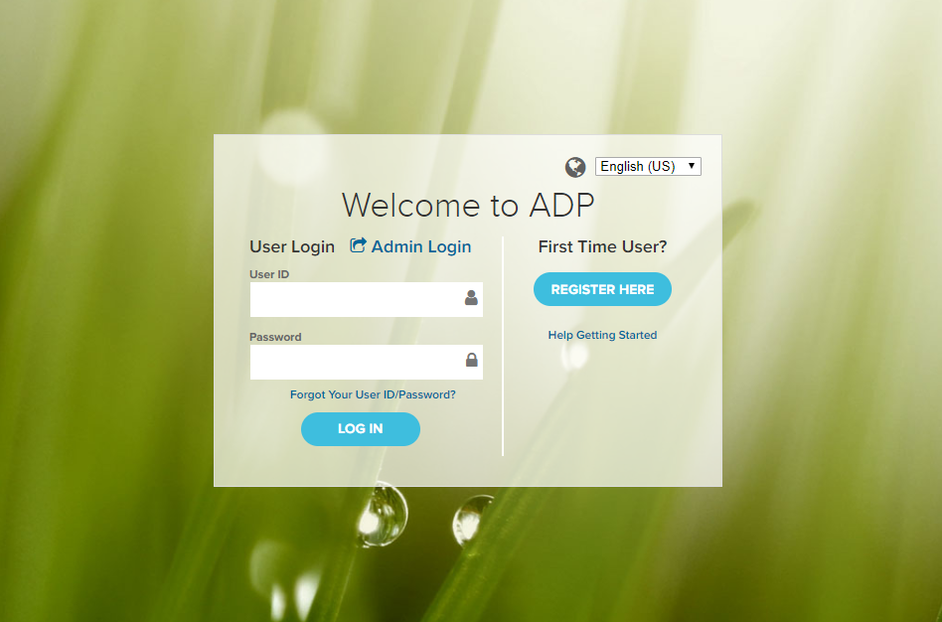
Login to Workforce Now https://workforcenow.adp.com/
The Registration passcode for new users is: Richards-1234.

Slide 3
Step by Step Summary
Creating a Time Off Request
Myself > Time Off > Request Time Off
1 In the calendar click the days you want to take off.
2 Click Request Time Off and verify the dates.
3 Click Change Recurrence to set up a repeating pattern.
4 Optional: For multiple days, click Edit Each Day Individually.
5 For each day off, select the Policy (PTO FT, Bereavement, Jury Duty, Unpaid Time Off)
6 To change the number of hours, click and type in the Amount and then click out of the field.
7 Verify the Start Time, or select another time.
Optional: Enter comments. Comments will be visible to your supervisor or HR Manager but not to team members.
8 In the Please Respond By field, you can click (calendar) to select a date.
9 Click Submit.

Slide 4
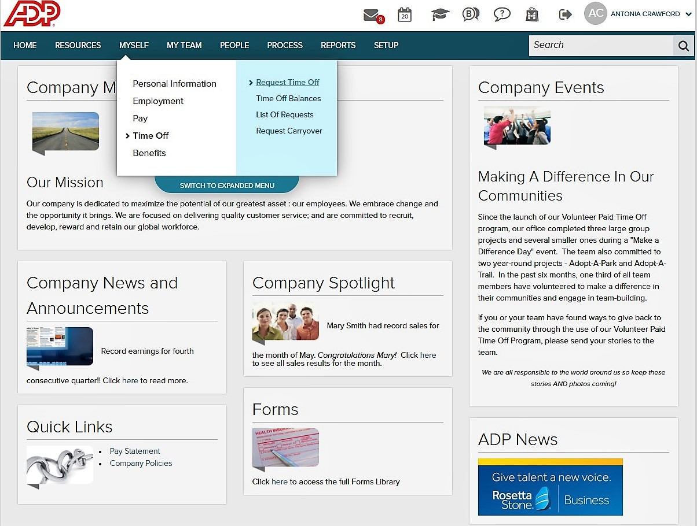
To get started click on Myself > Time Off > Request Time Off

Slide 5
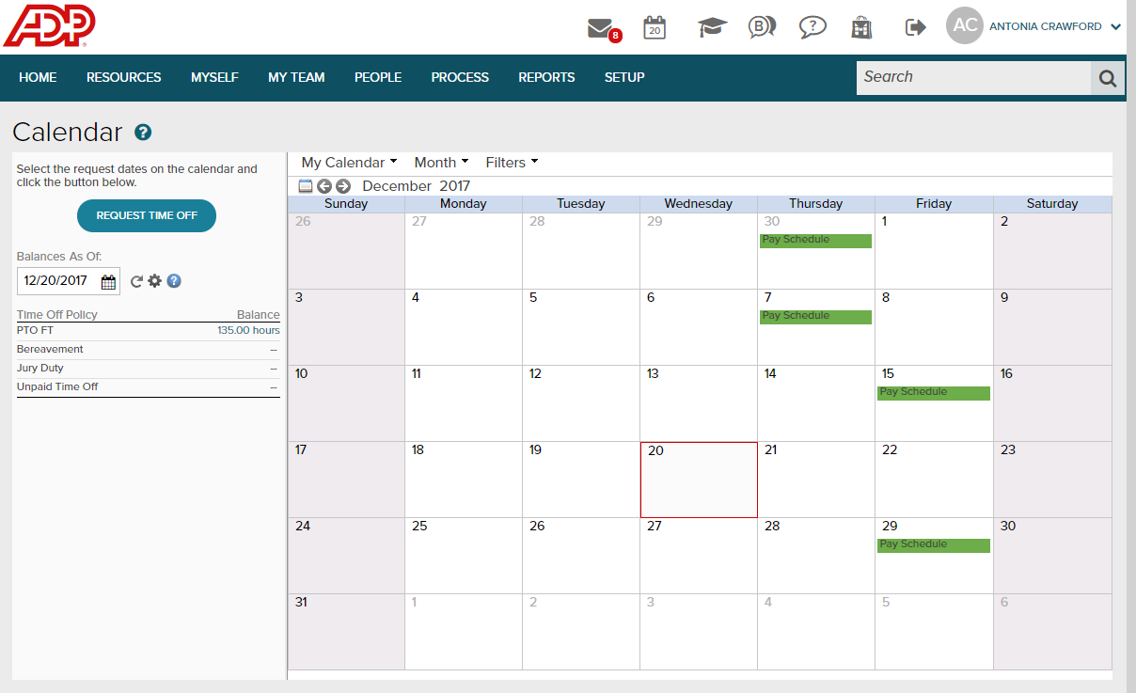
Submitting Time Off Request – select Request Time Off

Slide 6
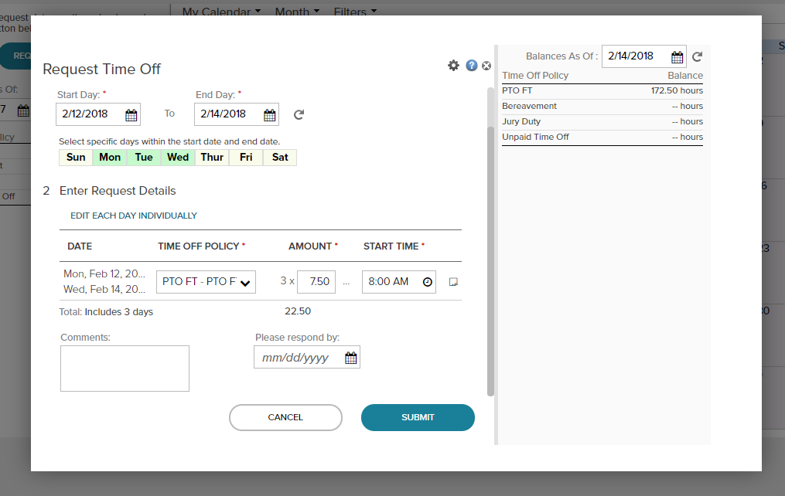
Submitting Time Off Request – Input Start Day and End Day. Select the correct Time Off Policy. PTO FT is for regular time off. You may select from Jury Duty, Bereavement & Unpaid Time Off as well when appropriate. Click “Edit Each Day Individually” if multiple request days.

Slide 7
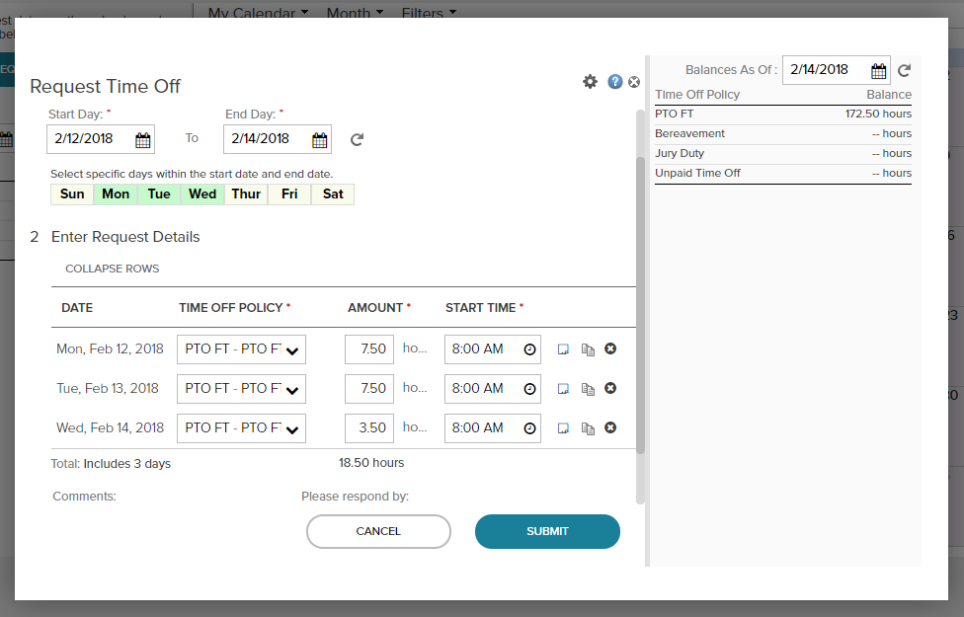
Submitting Time Off Request – Review and click Submit. This will generate an email to your supervisor. You will receive an email when your supervisor approves/denies your request.

Slide 8
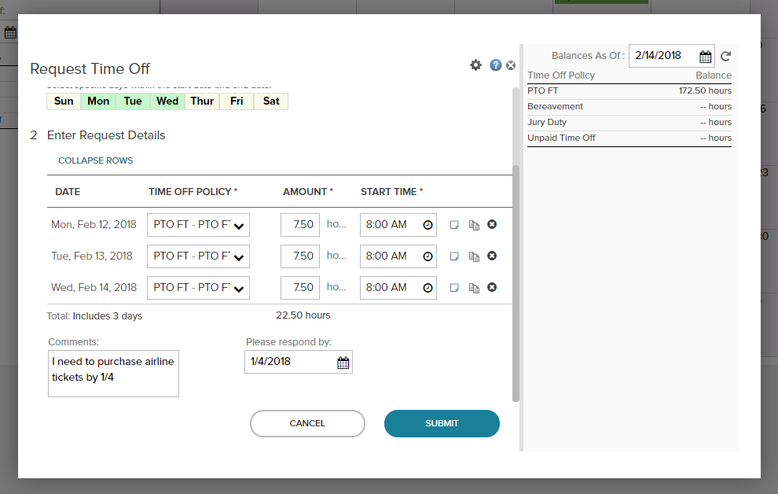
Submitting Time Off Request – You may input Comments or Respond Date if needed (not required).
Submit Request

Slide 9
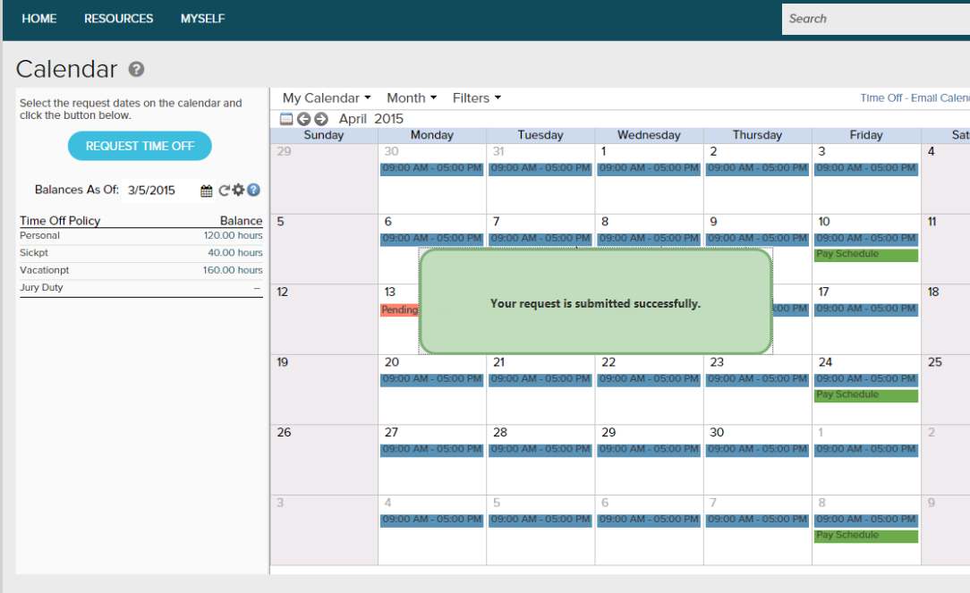
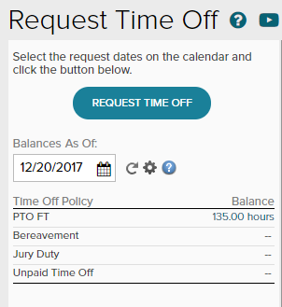
Submitting Time Off Request – Your Request is Submitted Successfully

Slide 10
Notification
Once you submit your request, your supervisor will receive a notification email notifying them that you have submitted a Time Off Request.
Your supervisor will review your request and either approve or deny it. Once they have approved or denied the request you will receive an email notifying you of the outcome.

Slide 11
Additional Information: - You may rescind or edit your requests until they are approved. Once they are approved please contact Antonia to make any needed adjustments. - You will see the pending and approved PTO requests of your teammates on the calendar. Please consider if there is adequate coverage before you submit a request. - Your 2017 carry over days are included in your 2018 available balance. If you think your bank was miscalculated reach out to Antonia and cc your supervisor. We will work with you to reconcile your bank accurately. - If you get stuck or need help, please contact your Administrator: Antonia Crawford acrawford@therichardsgrp.com
Submitting Time Off Request

